Slide 1
Sentiment analysis of Twitter comments related to COVID-19
Group 5
Dai Dong, Sijia Han, Frank Shi

Slide 2
Sentiment Analysis Approaches
machine learning approach
lexicon based approach
hybrid approach

Slide 3
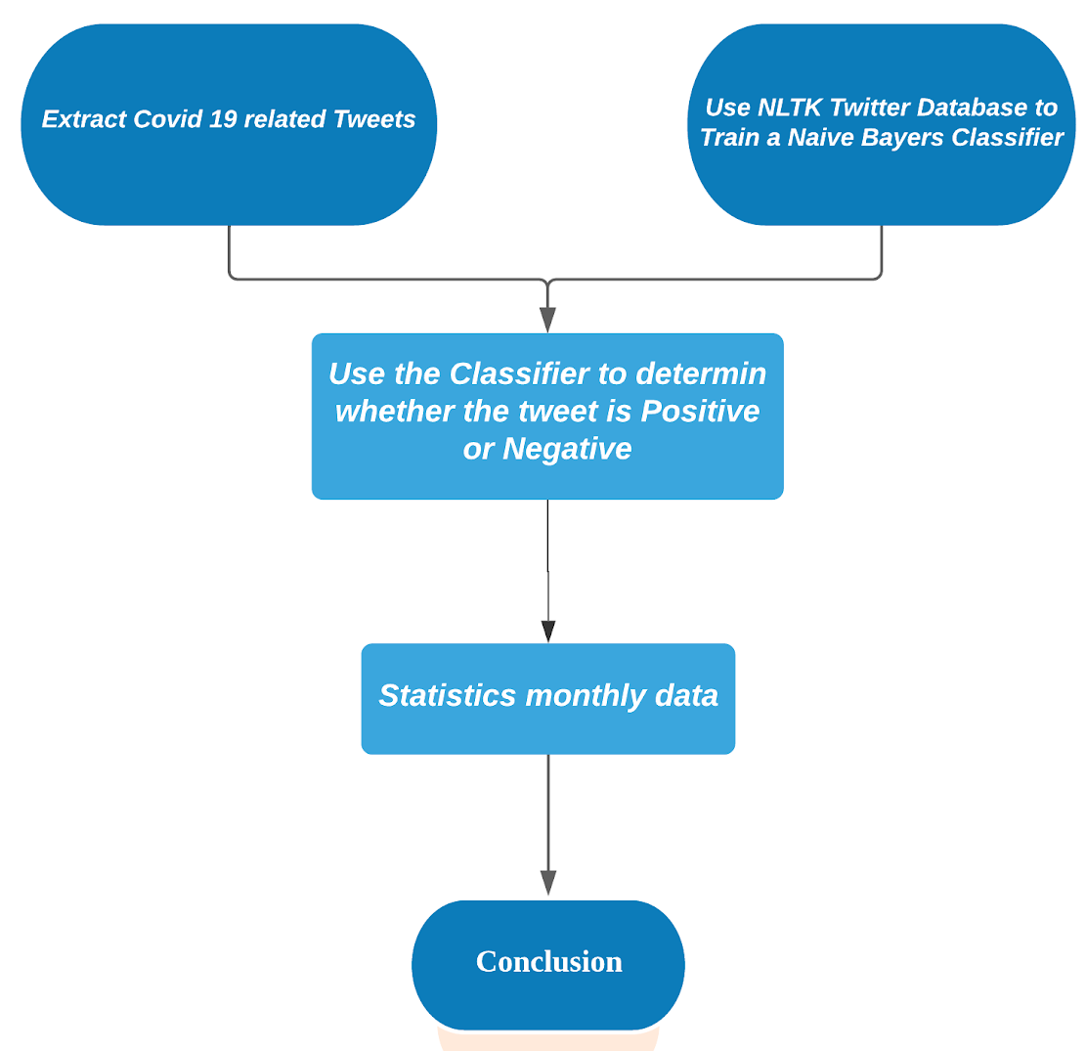
Our Main Approach

Slide 4
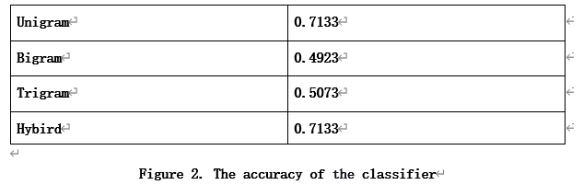
The N-gram Algorithm Accuracy Comparison

Slide 5
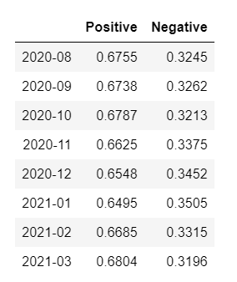
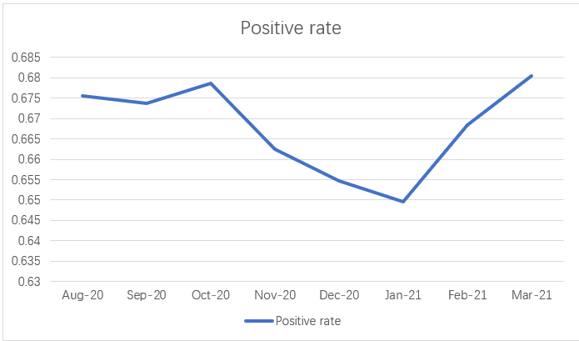
Average Positive/Negative rate of tweets related Covid-19

Slide 6
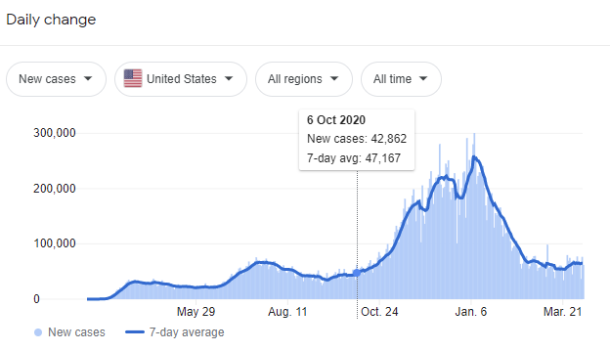
Comparison between positive/negative tweets and covid cases

Slide 7
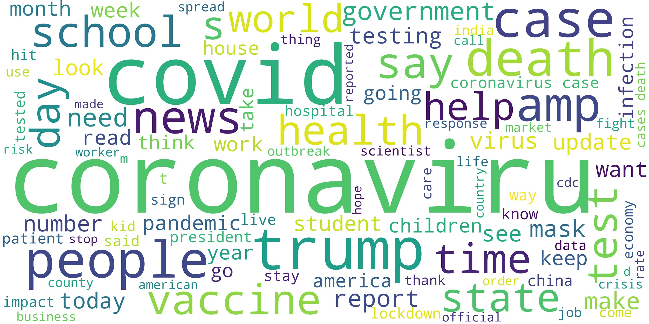
2020 August

Slide 8
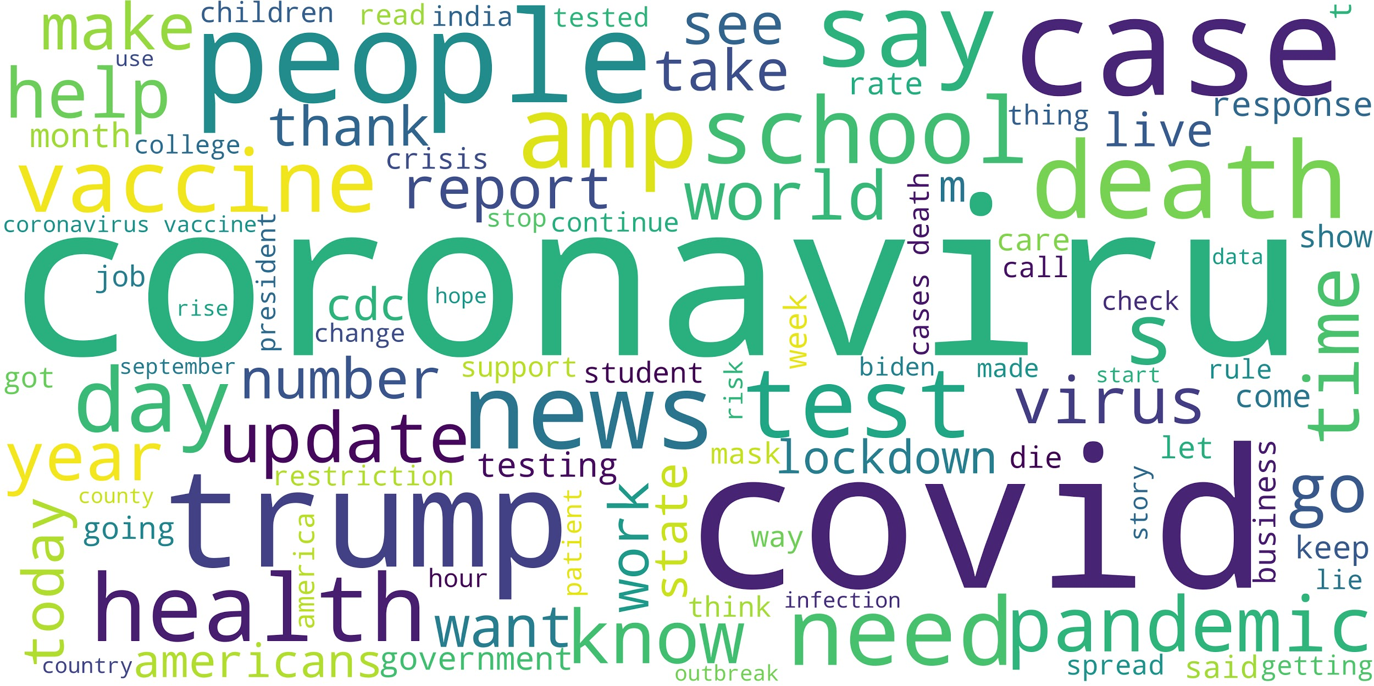
2020 September

Slide 9
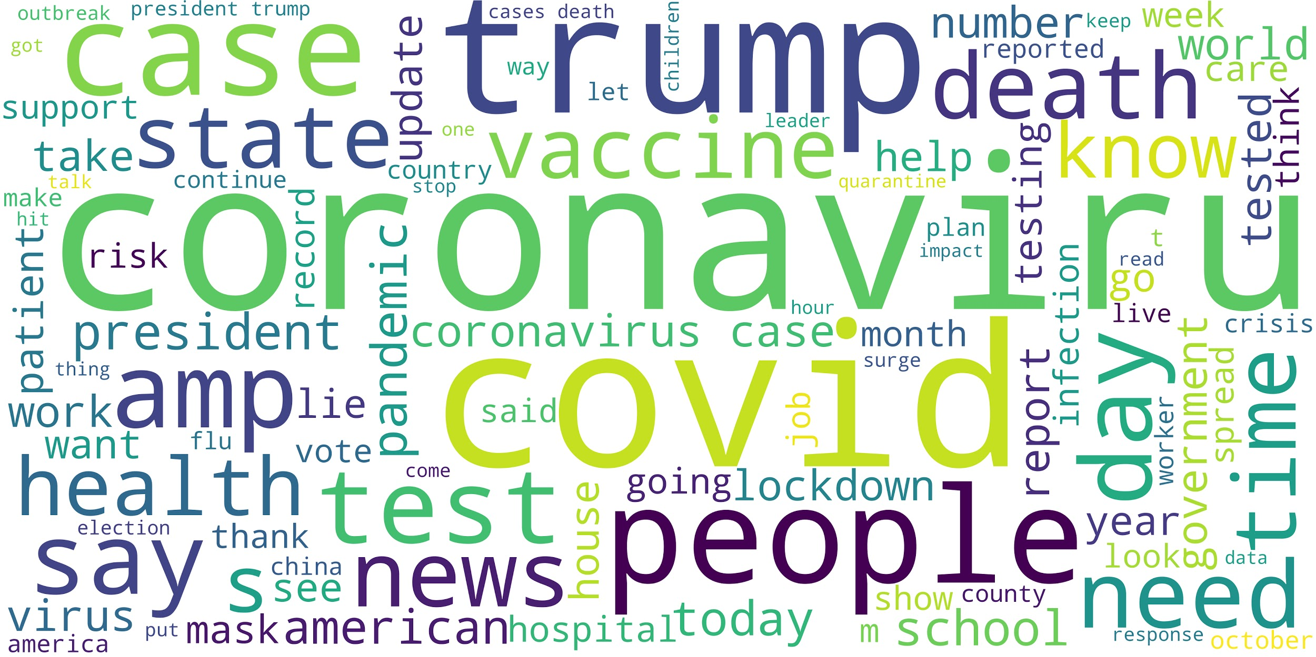
2020 October

Slide 10
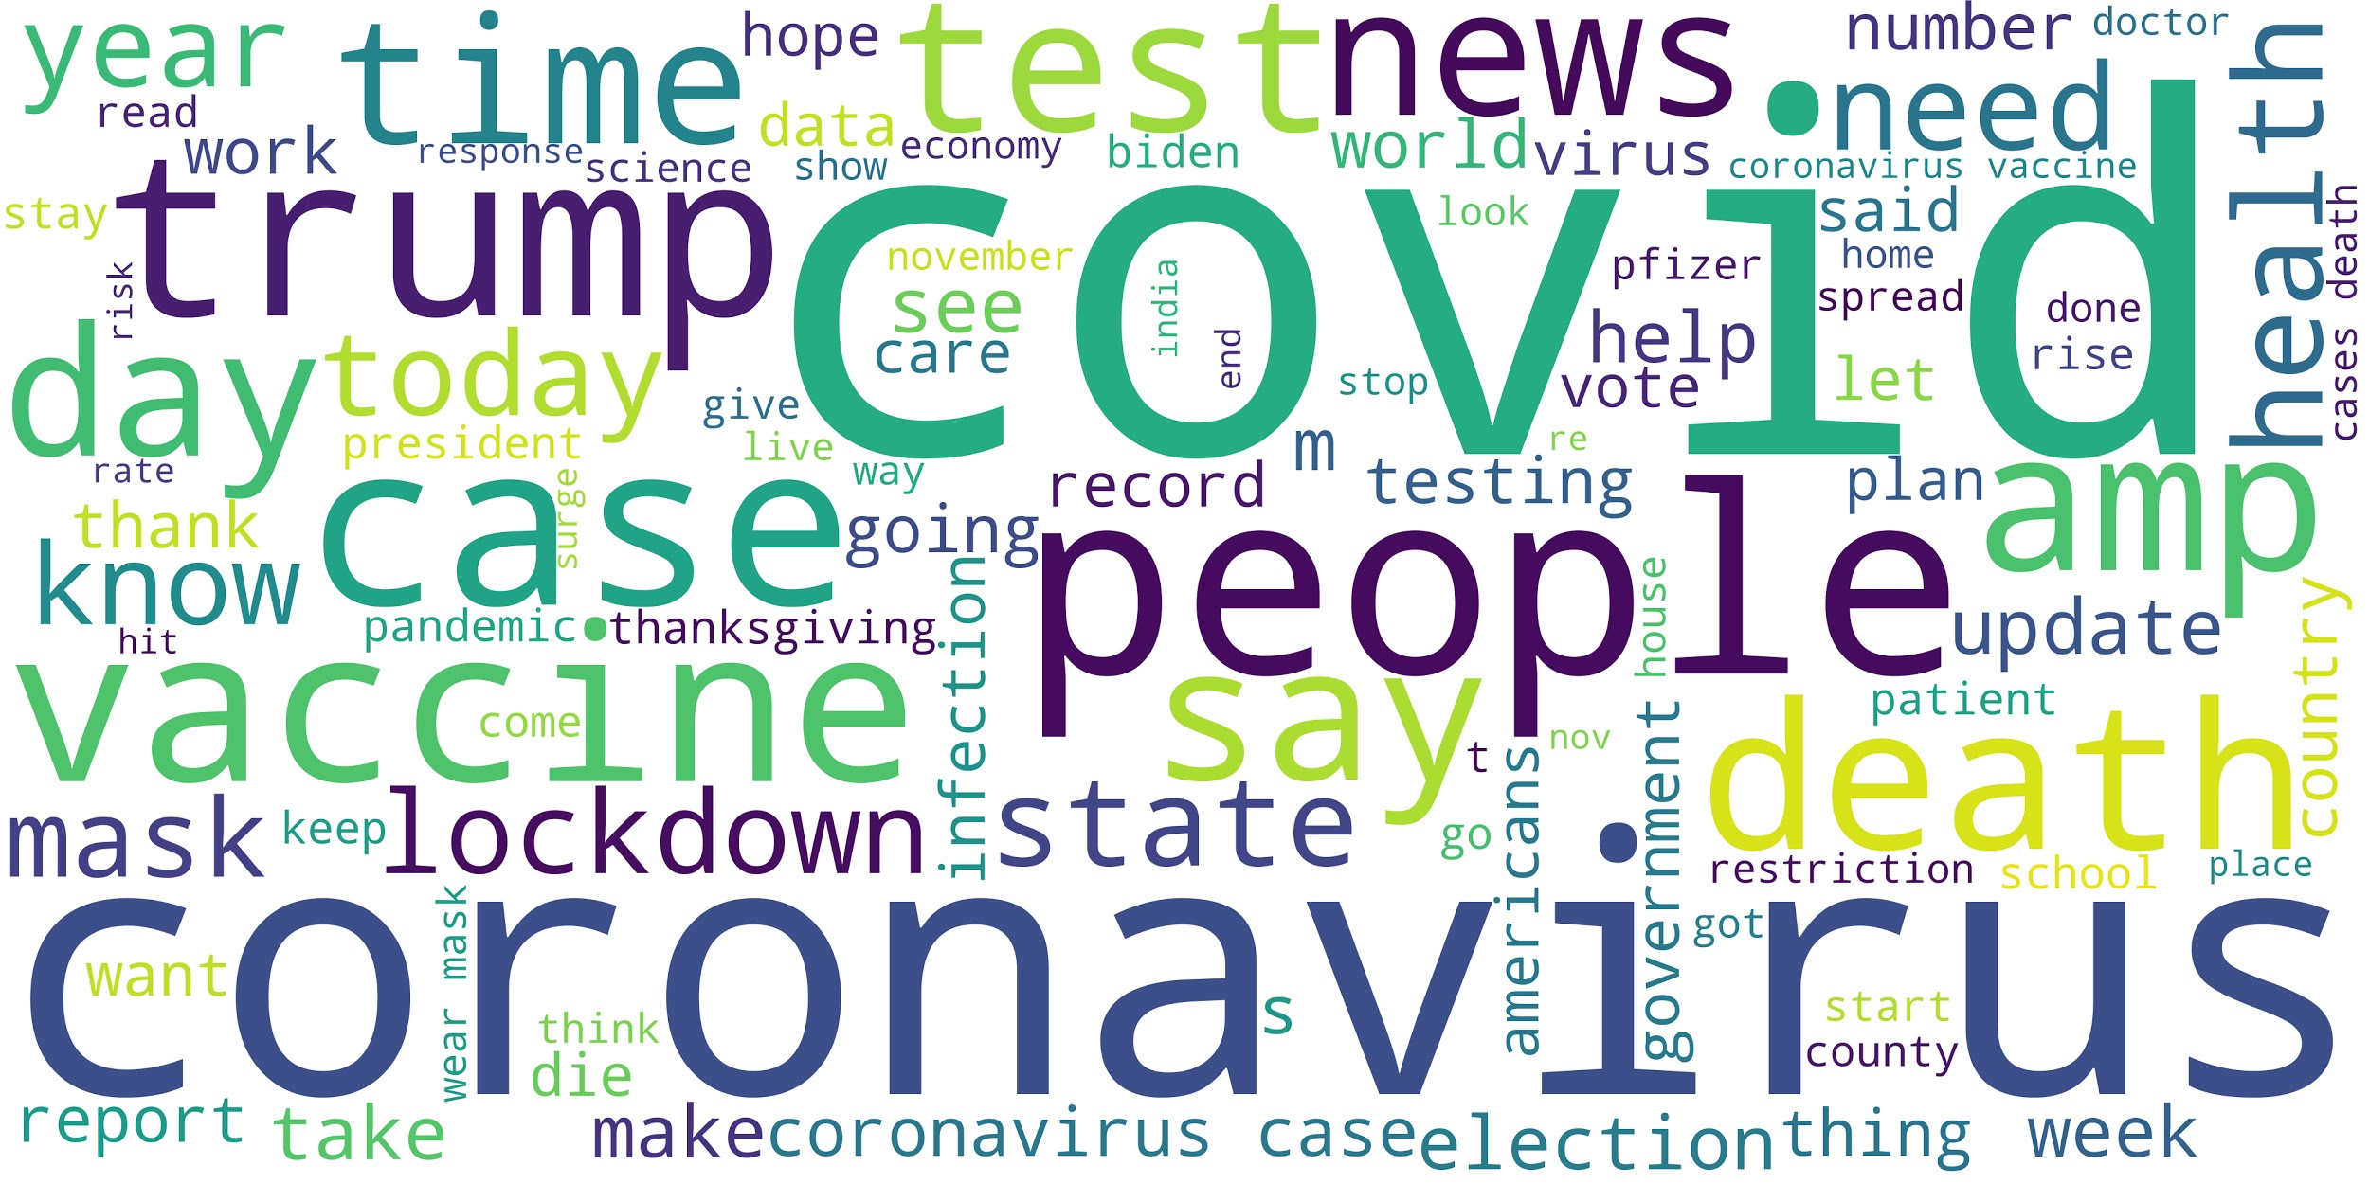
2020 November

Slide 11
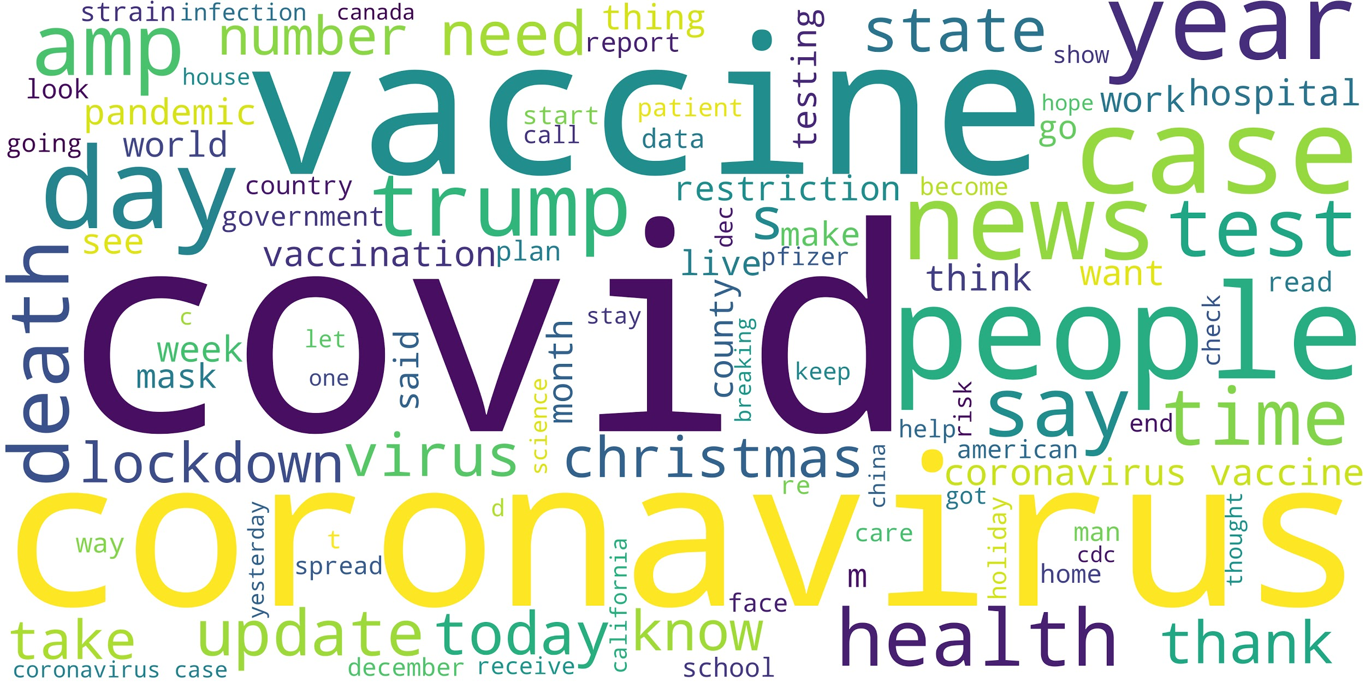
2020 December

Slide 12
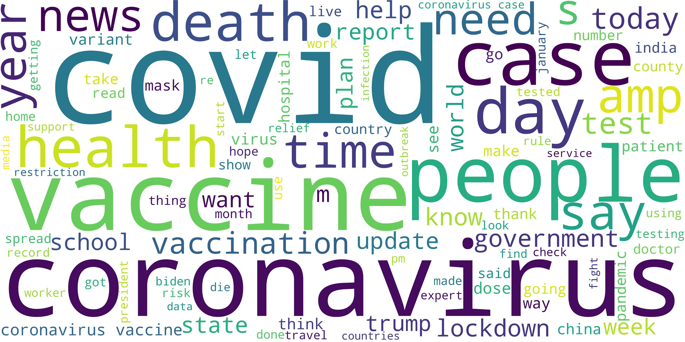
2021 January

Slide 13
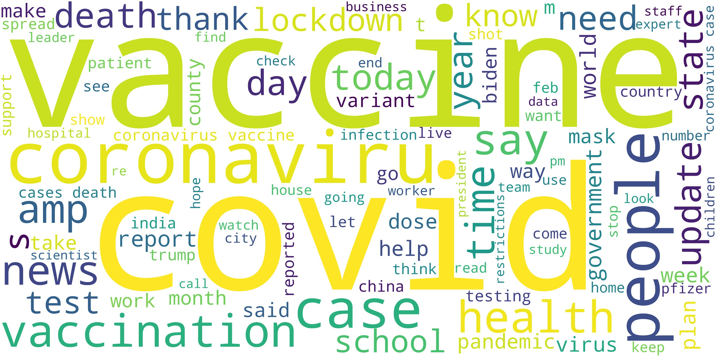
2021 February

Slide 14
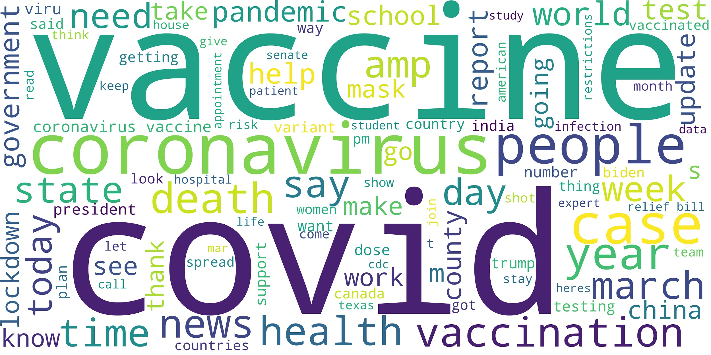
2021 March

Slide 15
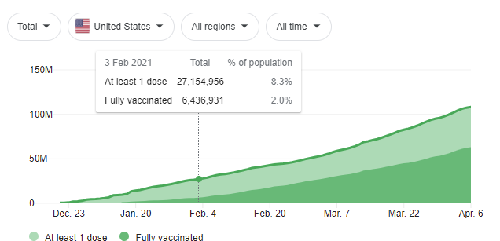
Covid Vaccine Dosing History

Slide 16
Thanks for listening !

